Slide 1
Bootstrap

Slide 2
What is Bootstrap?
Bootstrap is a free front-end framework for faster and easier web development
Bootstrap includes HTML and CSS based design templates for
typography, forms, buttons, tables, navigation, modals, image carousels and many other
optional JavaScript plugins
Bootstrap also gives you the ability to easily create responsive designs
Responsive web design is about creating web sites which automatically adjust themselves to look good on all devices, from small phones to large desktops.

Slide 3
Why Use Bootstrap?
Advantages of Bootstrap:
Easy to use: Anybody with just basic knowledge of HTML and CSS can start using Bootstrap
Responsive features: Bootstrap's responsive CSS adjusts to phones, tablets, and desktops
Mobile-first approach: In Bootstrap 3, mobile-first styles are part of the core framework
Browser compatibility: Bootstrap is compatible with all modern browsers (Chrome, Firefox, Internet Explorer, Edge, Safari, and Opera)

Slide 4
Where to Get Bootstrap?
Download Bootstrap from getbootstrap.com
Go to getbootstrap.com, and follow the instructions there.
Include Bootstrap from a CDN
If you don't want to download and host Bootstrap yourself, you can include it from a CDN (Content Delivery Network).
MaxCDN provides CDN support for Bootstrap's CSS and JavaScript. You must also include jQuery:
<!-- Latest compiled and minified CSS -->
<link rel="stylesheet" href="https://maxcdn.bootstrapcdn.com/bootstrap/3.4.1/css/bootstrap.min.css">
<!-- jQuery library -->
<script src="https://ajax.googleapis.com/ajax/libs/jquery/3.5.1/jquery.min.js"></script>
<!-- Latest compiled JavaScript -->
<script src="https://maxcdn.bootstrapcdn.com/bootstrap/3.4.1/js/bootstrap.min.js"></script>

Slide 5
Create First Web Page With Bootstrap
1. Add the HTML5 doctype
Bootstrap uses HTML elements and CSS properties that require the HTML5 doctype.
Always include the HTML5 doctype at the beginning of the page, along with the lang attribute and the correct character set:
<!DOCTYPE html>
<html lang="en">
<head>
<meta charset="utf-8">
</head>
</html>

Slide 6
Create First Web Page With Bootstrap
2. Bootstrap 3 is mobile-first
Bootstrap 3 is designed to be responsive to mobile devices.
Mobile-first styles are part of the core framework.
To ensure proper rendering and touch zooming, add the following <meta> tag inside the <head> element:
<meta name="viewport" content="width=device-width, initial-scale=1">
The width=device-width part sets the width of the page to follow the screen-width of the device
(which will vary depending on the device).
The initial-scale=1 part sets the initial zoom level when the page is first loaded by the browser.

Slide 7
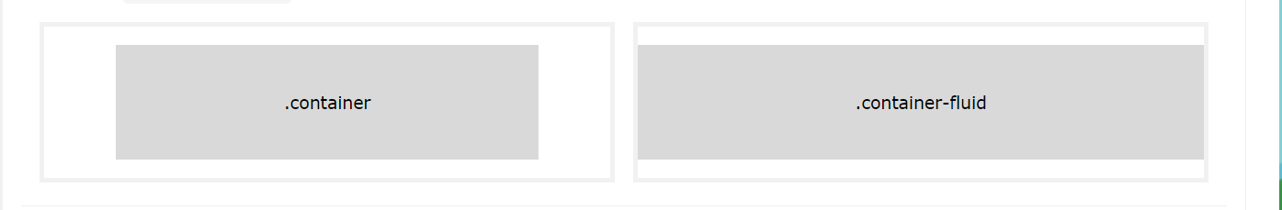
Create First Web Page With Bootstrap
3. Containers
Bootstrap also requires a containing element to wrap site contents.
There are two container classes to choose from:
The .container class provides a responsive fixed width container
The .container-fluid class provides a full width container, spanning the entire width of the viewport

Slide 8
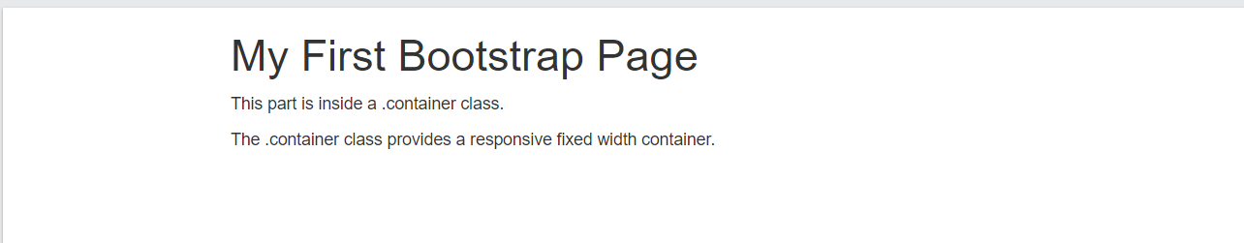
Examples
<!DOCTYPE html>
<html lang="en">
<head>
<title>Bootstrap Example</title>
<meta charset="utf-8">
<meta name="viewport" content="width=device-width, initial-scale=1">
<link rel="stylesheet" href="https://maxcdn.bootstrapcdn.com/bootstrap/3.4.1/css/bootstrap.min.css">
<script src="https://ajax.googleapis.com/ajax/libs/jquery/3.5.1/jquery.min.js"></script>
<script src="https://maxcdn.bootstrapcdn.com/bootstrap/3.4.1/js/bootstrap.min.js"></script>
</head>
<body>
<div class="container">
<h1>My First Bootstrap Page</h1>
<p>This part is inside a .container class.</p>
<p>The .container class provides a responsive fixed width container.</p>
</div>
</body>
</html>

Slide 9
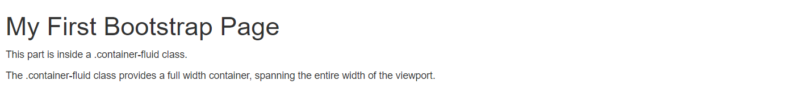
Examples
<!DOCTYPE html>
<html lang="en">
<head>
<title>Bootstrap Example</title>
<meta charset="utf-8">
<meta name="viewport" content="width=device-width, initial-scale=1">
<link rel="stylesheet" href="https://maxcdn.bootstrapcdn.com/bootstrap/3.4.1/css/bootstrap.min.css">
<script src="https://ajax.googleapis.com/ajax/libs/jquery/3.5.1/jquery.min.js"></script>
<script src="https://maxcdn.bootstrapcdn.com/bootstrap/3.4.1/js/bootstrap.min.js"></script>
</head>
<body>
<div class="container-fluid">
<h1>My First Bootstrap Page</h1>
<p>This part is inside a .container class.</p>
<p>The .container class provides a responsive fixed width container.</p>
</div>
</body>
</html>

Slide 10
Bootstrap Grid System

Slide 11
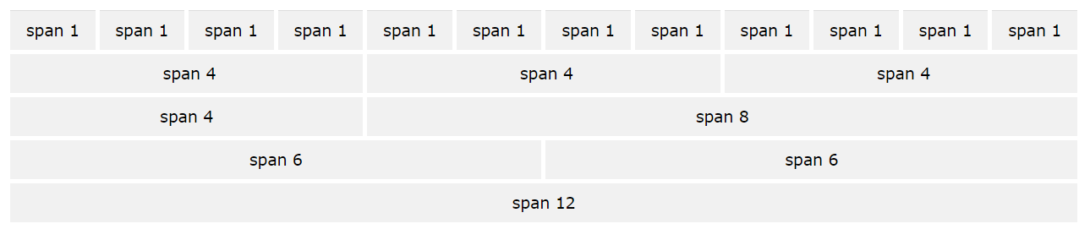
Bootstrap Grid System
Bootstrap's grid system allows up to 12 columns across the page.
If you do not want to use all 12 columns individually, you can group the columns together to create wider columns
Bootstrap's grid system is responsive, and the columns will re-arrange automatically depending on the screen size.

Slide 12
Grid Classes
The Bootstrap grid system has four classes:
xs (for phones - screens less than 768px wide)
sm (for tablets - screens equal to or greater than 768px wide)
md (for small laptops - screens equal to or greater than 992px wide)
lg (for laptops and desktops - screens equal to or greater than 1200px wide)
The classes above can be combined to create more dynamic and flexible layouts.

Slide 13
Grid Classes
Basic Structure of a Bootstrap Grid
<div class="row">
<div class="col-*-*"></div>
<div class="col-*-*"></div>
</div>
<div class="row">
<div class="col-*-*"></div>
<div class="col-*-*"></div>
<div class="col-*-*"></div>
</div>
<div class="row">
...
…
</div>
First: create a row (<div class="row">).
Add the desired number of columns (tags with appropriate .col-*-* classes).
Note that numbers in .col-*-* should always add up to 12 for each row.

Slide 14
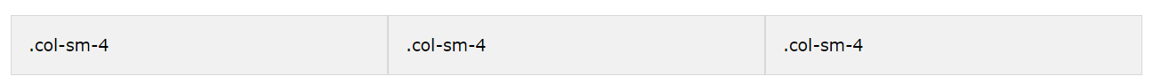
Grid Classes
Three Equal Columns
<div class="row">
<div class="col-sm-4">.col-sm-4</div>
<div class="col-sm-4">.col-sm-4</div>
<div class="col-sm-4">.col-sm-4</div>
</div>
The example shows how to get a three equal-width columns starting at tablets and scaling to large desktops.
On mobile phones or screens that are less than 768px wide, the columns will automatically stack

Slide 15
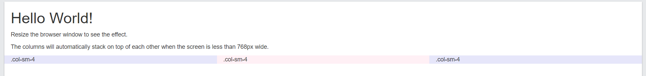
Examples
<!DOCTYPE html>
<html lang="en">
<head>
<title>Bootstrap Example</title>
<meta charset="utf-8">
<meta name="viewport" content="width=device-width, initial-scale=1">
<link rel="stylesheet" href="https://maxcdn.bootstrapcdn.com/bootstrap/3.4.1/css/bootstrap.min.css">
<script src="https://ajax.googleapis.com/ajax/libs/jquery/3.5.1/jquery.min.js"></script>
<script src="https://maxcdn.bootstrapcdn.com/bootstrap/3.4.1/js/bootstrap.min.js"></script>
</head>
<body>
<div class="container-fluid">
<h1>Hello World!</h1>
<p>Resize the browser window to see the effect.</p>
<p>The columns will automatically stack on top of each other when the screen is less than 768px wide.</p>
<div class="row">
<div class="col-sm-4" style="background-color:lavender;">.col-sm-4</div>
<div class="col-sm-4" style="background-color:lavenderblush;">.col-sm-4</div>
<div class="col-sm-4" style="background-color:lavender;">.col-sm-4</div>
</div>
</div>
</body>
</html>

Slide 16
<!DOCTYPE html>
<html lang="en">
<head>
<title>Bootstrap Example</title>
<meta charset="utf-8">
<meta name="viewport" content="width=device-width, initial-scale=1">
<link rel="stylesheet" href="https://maxcdn.bootstrapcdn.com/bootstrap/3.4.1/css/bootstrap.min.css">
<script src="https://ajax.googleapis.com/ajax/libs/jquery/3.5.1/jquery.min.js"></script>
<script src="https://maxcdn.bootstrapcdn.com/bootstrap/3.4.1/js/bootstrap.min.js"></script>
</head>
<body>
<div class="container-fluid">
<h1>Hello World!</h1>
<p>Resize the browser window to see the effect.</p>
<p>The columns will automatically stack on top of each other when the screen is less than 768px wide.</p>
<div class="row">
<div class="col-sm-4" style="background-color:lavender;">.col-sm-4</div>
<div class="col-sm-4" style="background-color:lavenderblush;">.col-sm-4</div>
<div class="col-sm-4" style="background-color:lavender;">.col-sm-4</div>
</div>
</div>
</body>
</html>

Slide 17
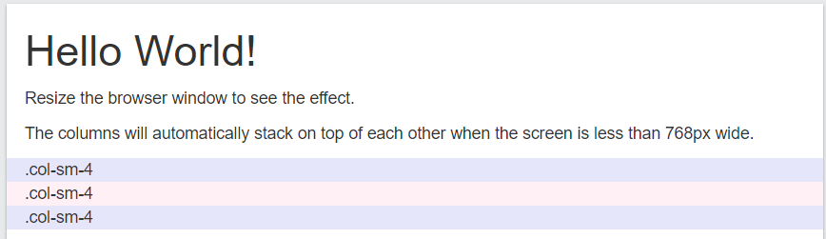
Examples

Slide 18
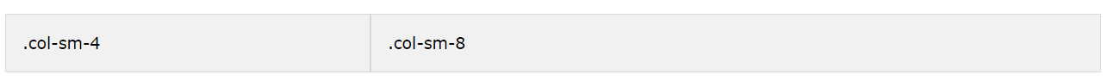
Grid Classes
Two unequal Columns
<div class="row">
<div class="col-sm-4">.col-sm-4</div>
<div class="col-sm-8">.col-sm-8</div>
</div>
The example shows how to get two various-width columns starting at tablets and scaling to large desktops

Slide 19
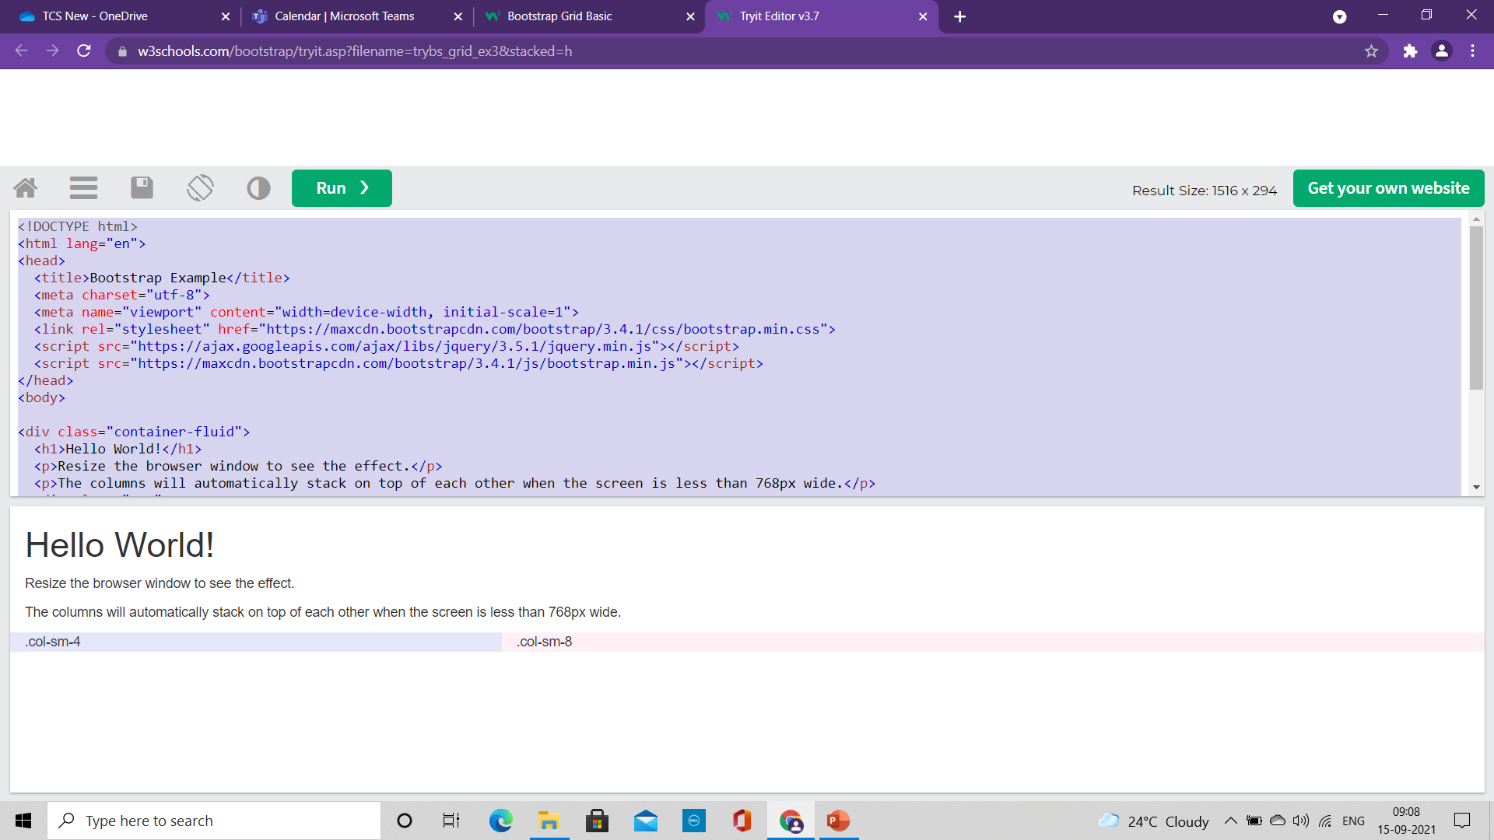
Examples
<!DOCTYPE html>
<html lang="en">
<head>
<title>Bootstrap Example</title>
<meta charset="utf-8">
<meta name="viewport" content="width=device-width, initial-scale=1">
<link rel="stylesheet" href="https://maxcdn.bootstrapcdn.com/bootstrap/3.4.1/css/bootstrap.min.css">
<script src="https://ajax.googleapis.com/ajax/libs/jquery/3.5.1/jquery.min.js"></script>
<script src="https://maxcdn.bootstrapcdn.com/bootstrap/3.4.1/js/bootstrap.min.js"></script>
</head>
<body>
<div class="container-fluid">
<h1>Hello World!</h1>
<p>Resize the browser window to see the effect.</p>
<p>The columns will automatically stack on top of each other when the screen is less than 768px wide.</p>
<div class="row">
<div class="col-sm-4" style="background-color:lavender;">.col-sm-4</div>
<div class="col-sm-8" style="background-color:lavenderblush;">.col-sm-8</div>
</div>
</div>
</body>
</html>

Slide 20
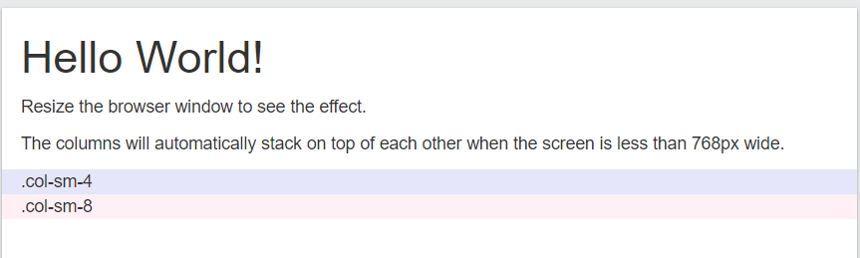
Examples
<!DOCTYPE html>
<html lang="en">
<head>
<title>Bootstrap Example</title>
<meta charset="utf-8">
<meta name="viewport" content="width=device-width, initial-scale=1">
<link rel="stylesheet" href="https://maxcdn.bootstrapcdn.com/bootstrap/3.4.1/css/bootstrap.min.css">
<script src="https://ajax.googleapis.com/ajax/libs/jquery/3.5.1/jquery.min.js"></script>
<script src="https://maxcdn.bootstrapcdn.com/bootstrap/3.4.1/js/bootstrap.min.js"></script>
</head>
<body>
<div class="container-fluid">
<h1>Hello World!</h1>
<p>Resize the browser window to see the effect.</p>
<p>The columns will automatically stack on top of each other when the screen is less than 768px wide.</p>
<div class="row">
<div class="col-sm-4" style="background-color:lavender;">.col-sm-4</div>
<div class="col-sm-8" style="background-color:lavenderblush;">.col-sm-8</div>
</div>
</div>
</body>
</html>

Slide 21
Bootstrap Button

Slide 22
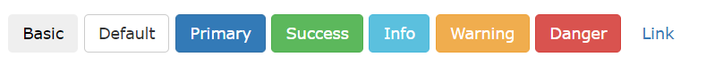
Bootstrap Buttons
Bootstrap provides different styles of buttons
To achieve the button styles above, Bootstrap has the following classes:
.btn
.btn-default
.btn-primary
.btn-success
.btn-info
.btn-warning
.btn-danger
.btn-link

Slide 23
Bootstrap Buttons
<!DOCTYPE html>
<html lang="en">
<head>
<title>Bootstrap Example</title>
<meta charset="utf-8">
<meta name="viewport" content="width=device-width, initial-scale=1">
<link rel="stylesheet" href="https://maxcdn.bootstrapcdn.com/bootstrap/3.4.1/css/bootstrap.min.css">
<script src="https://ajax.googleapis.com/ajax/libs/jquery/3.5.1/jquery.min.js"></script>
<script src="https://maxcdn.bootstrapcdn.com/bootstrap/3.4.1/js/bootstrap.min.js"></script>
</head>
<body>
<div class="container">
<h2>Button Styles</h2>
<button type="button" class="btn">Basic</button>
<button type="button" class="btn btn-default">Default</button>
<button type="button" class="btn btn-primary">Primary</button>
<button type="button" class="btn btn-success">Success</button>
<button type="button" class="btn btn-info">Info</button>
<button type="button" class="btn btn-warning">Warning</button>
<button type="button" class="btn btn-danger">Danger</button>
<button type="button" class="btn btn-link">Link</button>
</div>
</body>
</html>

Slide 24
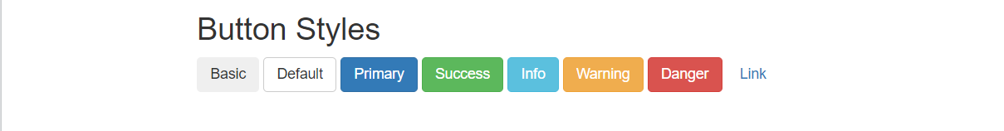
Bootstrap Buttons
<!DOCTYPE html>
<html lang="en">
<head>
<title>Bootstrap Example</title>
<meta charset="utf-8">
<meta name="viewport" content="width=device-width, initial-scale=1">
<link rel="stylesheet" href="https://maxcdn.bootstrapcdn.com/bootstrap/3.4.1/css/bootstrap.min.css">
<script src="https://ajax.googleapis.com/ajax/libs/jquery/3.5.1/jquery.min.js"></script>
<script src="https://maxcdn.bootstrapcdn.com/bootstrap/3.4.1/js/bootstrap.min.js"></script>
</head>
<body>
<div class="container">
<h2>Button Styles</h2>
<button type="button" class="btn">Basic</button>
<button type="button" class="btn btn-default">Default</button>
<button type="button" class="btn btn-primary">Primary</button>
<button type="button" class="btn btn-success">Success</button>
<button type="button" class="btn btn-info">Info</button>
<button type="button" class="btn btn-warning">Warning</button>
<button type="button" class="btn btn-danger">Danger</button>
<button type="button" class="btn btn-link">Link</button>
</div>
</body>
</html>

Slide 25
Bootstrap Buttons
<!DOCTYPE html>
<html lang="en">
<head>
<title>Bootstrap Example</title>
<meta charset="utf-8">
<meta name="viewport" content="width=device-width, initial-scale=1">
<link rel="stylesheet" href="https://maxcdn.bootstrapcdn.com/bootstrap/3.4.1/css/bootstrap.min.css">
<script src="https://ajax.googleapis.com/ajax/libs/jquery/3.5.1/jquery.min.js"></script>
<script src="https://maxcdn.bootstrapcdn.com/bootstrap/3.4.1/js/bootstrap.min.js"></script>
</head>
<body>
<div class="container">
<h2>Button Tags</h2>
<a href="#" class="btn btn-info" role="button">Link Button</a>
<button type="button" class="btn btn-info">Button</button>
<input type="button" class="btn btn-info" value="Input Button">
<input type="submit" class="btn btn-info" value="Submit Button">
</div>
</body>
</html>
The button classes can be used on an <a>, <button>, or <input> element
we do not have any page to link it to, and we do not want to get a "404" message, we put # as the link in our examples. It should be a real URL to a specific page.

Slide 26
Bootstrap Buttons
<!DOCTYPE html>
<html lang="en">
<head>
<title>Bootstrap Example</title>
<meta charset="utf-8">
<meta name="viewport" content="width=device-width, initial-scale=1">
<link rel="stylesheet" href="https://maxcdn.bootstrapcdn.com/bootstrap/3.4.1/css/bootstrap.min.css">
<script src="https://ajax.googleapis.com/ajax/libs/jquery/3.5.1/jquery.min.js"></script>
<script src="https://maxcdn.bootstrapcdn.com/bootstrap/3.4.1/js/bootstrap.min.js"></script>
</head>
<body>
<div class="container">
<h2>Button Tags</h2>
<a href="#" class="btn btn-info" role="button">Link Button</a>
<button type="button" class="btn btn-info">Button</button>
<input type="button" class="btn btn-info" value="Input Button">
<input type="submit" class="btn btn-info" value="Submit Button">
</div>
</body>
</html>

Slide 27
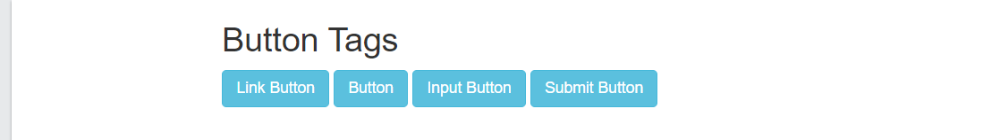
Bootstrap Buttons
<!DOCTYPE html>
<html lang="en">
<head>
<title>Bootstrap Example</title>
<meta charset="utf-8">
<meta name="viewport" content="width=device-width, initial-scale=1">
<link rel="stylesheet" href="https://maxcdn.bootstrapcdn.com/bootstrap/3.4.1/css/bootstrap.min.css">
<script src="https://ajax.googleapis.com/ajax/libs/jquery/3.5.1/jquery.min.js"></script>
<script src="https://maxcdn.bootstrapcdn.com/bootstrap/3.4.1/js/bootstrap.min.js"></script>
</head>
<body>
<div class="container">
<h2>Button Tags</h2>
<a href="#" class="btn btn-info" role="button">Link Button</a>
<button type="button" class="btn btn-info">Button</button>
<input type="button" class="btn btn-info" value="Input Button">
<input type="submit" class="btn btn-info" value="Submit Button">
</div>
</body>
</html>

Slide 28
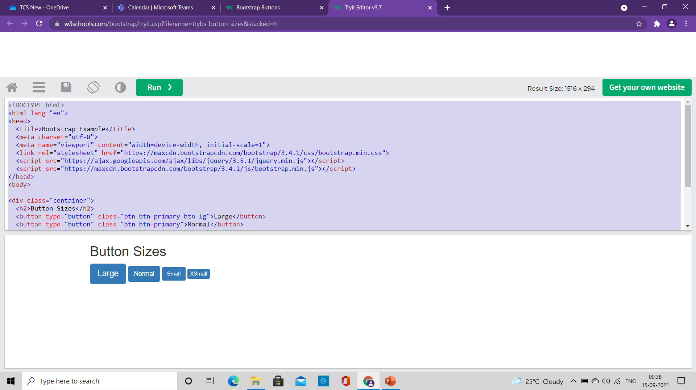
Bootstrap Button Sizes
<!DOCTYPE html>
<html lang="en">
<head>
<title>Bootstrap Example</title>
<meta charset="utf-8">
<meta name="viewport" content="width=device-width, initial-scale=1">
<link rel="stylesheet" href="https://maxcdn.bootstrapcdn.com/bootstrap/3.4.1/css/bootstrap.min.css">
<script src="https://ajax.googleapis.com/ajax/libs/jquery/3.5.1/jquery.min.js"></script>
<script src="https://maxcdn.bootstrapcdn.com/bootstrap/3.4.1/js/bootstrap.min.js"></script>
</head>
<body>
<div class="container">
<h2>Button Sizes</h2>
<button type="button" class="btn btn-primary btn-lg">Large</button>
<button type="button" class="btn btn-primary">Normal</button>
<button type="button" class="btn btn-primary btn-sm">Small</button>
<button type="button" class="btn btn-primary btn-xs">XSmall</button>
</div>
</body>
</html>
Bootstrap provides four button sizes:
The classes that define the different sizes are:
.btn-lg
.btn-sm
.btn-xs

Slide 29
Bootstrap Button Sizes
<!DOCTYPE html>
<html lang="en">
<head>
<title>Bootstrap Example</title>
<meta charset="utf-8">
<meta name="viewport" content="width=device-width, initial-scale=1">
<link rel="stylesheet" href="https://maxcdn.bootstrapcdn.com/bootstrap/3.4.1/css/bootstrap.min.css">
<script src="https://ajax.googleapis.com/ajax/libs/jquery/3.5.1/jquery.min.js"></script>
<script src="https://maxcdn.bootstrapcdn.com/bootstrap/3.4.1/js/bootstrap.min.js"></script>
</head>
<body>
<div class="container">
<h2>Button Sizes</h2>
<button type="button" class="btn btn-primary btn-lg">Large</button>
<button type="button" class="btn btn-primary">Normal</button>
<button type="button" class="btn btn-primary btn-sm">Small</button>
<button type="button" class="btn btn-primary btn-xs">XSmall</button>
</div>
</body>
</html>

Slide 30
Bootstrap Button Sizes
<!DOCTYPE html>
<html lang="en">
<head>
<title>Bootstrap Example</title>
<meta charset="utf-8">
<meta name="viewport" content="width=device-width, initial-scale=1">
<link rel="stylesheet" href="https://maxcdn.bootstrapcdn.com/bootstrap/3.4.1/css/bootstrap.min.css">
<script src="https://ajax.googleapis.com/ajax/libs/jquery/3.5.1/jquery.min.js"></script>
<script src="https://maxcdn.bootstrapcdn.com/bootstrap/3.4.1/js/bootstrap.min.js"></script>
</head>
<body>
<div class="container">
<h2>Button Sizes</h2>
<button type="button" class="btn btn-primary btn-lg">Large</button>
<button type="button" class="btn btn-primary">Normal</button>
<button type="button" class="btn btn-primary btn-sm">Small</button>
<button type="button" class="btn btn-primary btn-xs">XSmall</button>
</div>
</body>
</html>

Slide 31
Bootstrap Forms

Slide 32
Bootstrap Forms
Bootstrap Default Settings
Form controls automatically receive some global styling with Bootstrap:
All textual <input>, <textarea>, and <select> elements with class .form-control have a width of 100%.
Bootstrap Form Layouts
Bootstrap provides three types of form layouts:
Vertical form (this is default)
Horizontal form
Inline form
Standard rules for all three form layouts:
Wrap labels and form controls in <div class="form-group"> (needed for optimum spacing)
Add class .form-control to all textual <input>, <textarea>, and <select> elements

Slide 33
Bootstrap Vertical Form
<!DOCTYPE html>
<html lang="en">
<head>
<title>Bootstrap Example</title>
<meta charset="utf-8">
<meta name="viewport" content="width=device-width, initial-scale=1">
<link rel="stylesheet" href="https://maxcdn.bootstrapcdn.com/bootstrap/3.4.1/css/bootstrap.min.css">
<script src="https://ajax.googleapis.com/ajax/libs/jquery/3.5.1/jquery.min.js"></script>
<script src="https://maxcdn.bootstrapcdn.com/bootstrap/3.4.1/js/bootstrap.min.js"></script>
</head>
<body>
<div class="container">
<h2>Vertical (basic) form</h2>
<form action="/action_page.php">
<div class="form-group">
<label for="email">Email:</label>
<input type="email" class="form-control" id="email" placeholder="Enter email" name="email">
</div>
<div class="form-group">
<label for="pwd">Password:</label>
<input type="password" class="form-control" id="pwd" placeholder="Enter password" name="pwd">
</div>
<div class="checkbox">
<label><input type="checkbox" name="remember"> Remember me</label>
</div>
<button type="submit" class="btn btn-default">Submit</button>
</form>
</div>
</body>
</html>

Slide 34
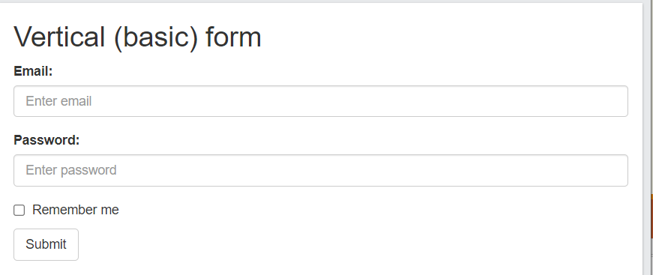
Bootstrap Vertical Form
<!DOCTYPE html>
<html lang="en">
<head>
<title>Bootstrap Example</title>
<meta charset="utf-8">
<meta name="viewport" content="width=device-width, initial-scale=1">
<link rel="stylesheet" href="https://maxcdn.bootstrapcdn.com/bootstrap/3.4.1/css/bootstrap.min.css">
<script src="https://ajax.googleapis.com/ajax/libs/jquery/3.5.1/jquery.min.js"></script>
<script src="https://maxcdn.bootstrapcdn.com/bootstrap/3.4.1/js/bootstrap.min.js"></script>
</head>
<body>
<div class="container">
<h2>Vertical (basic) form</h2>
<form action="/action_page.php">
<div class="form-group">
<label for="email">Email:</label>
<input type="email" class="form-control" id="email" placeholder="Enter email" name="email">
</div>
<div class="form-group">
<label for="pwd">Password:</label>
<input type="password" class="form-control" id="pwd" placeholder="Enter password" name="pwd">
</div>
<div class="checkbox">
<label><input type="checkbox" name="remember"> Remember me</label>
</div>
<button type="submit" class="btn btn-default">Submit</button>
</form>
</div>
</body>
</html>

Slide 35
Bootstrap Inline Form
<!DOCTYPE html>
<html lang="en">
<head>
<title>Bootstrap Example</title>
<meta charset="utf-8">
<meta name="viewport" content="width=device-width, initial-scale=1">
<link rel="stylesheet" href="https://maxcdn.bootstrapcdn.com/bootstrap/3.4.1/css/bootstrap.min.css">
<script src="https://ajax.googleapis.com/ajax/libs/jquery/3.5.1/jquery.min.js"></script>
<script src="https://maxcdn.bootstrapcdn.com/bootstrap/3.4.1/js/bootstrap.min.js"></script>
</head>
<body>
<div class="container">
<h2>Inline form</h2>
<p>Make the viewport larger than 768px wide to see that all of the form elements are inline, left aligned, and the labels are alongside.</p>
<form class="form-inline" action="/action_page.php">
<div class="form-group">
<label for="email">Email:</label>
<input type="email" class="form-control" id="email" placeholder="Enter email" name="email">
</div>
<div class="form-group">
<label for="pwd">Password:</label>
<input type="password" class="form-control" id="pwd" placeholder="Enter password" name="pwd">
</div>
<div class="checkbox">
<label><input type="checkbox" name="remember"> Remember me</label>
</div>
<button type="submit" class="btn btn-default">Submit</button>
</form>
</div>
</body>
</html>
In an inline form, all of the elements are inline, left-aligned, and the labels are alongside.
Note: This only applies to forms within viewports that are at least 768px wide!
Additional rule for an inline form:
Add class .form-inline to the <form> element

Slide 36
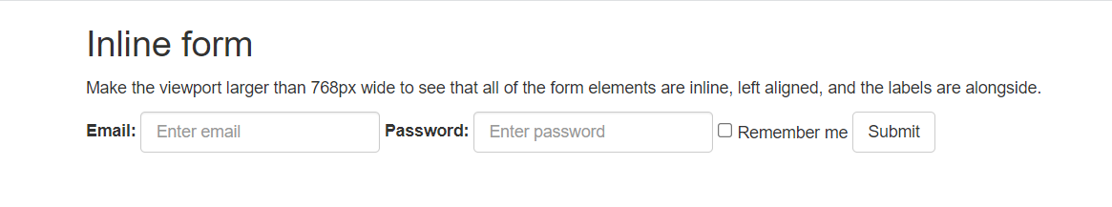
Bootstrap Inline Form
<!DOCTYPE html>
<html lang="en">
<head>
<title>Bootstrap Example</title>
<meta charset="utf-8">
<meta name="viewport" content="width=device-width, initial-scale=1">
<link rel="stylesheet" href="https://maxcdn.bootstrapcdn.com/bootstrap/3.4.1/css/bootstrap.min.css">
<script src="https://ajax.googleapis.com/ajax/libs/jquery/3.5.1/jquery.min.js"></script>
<script src="https://maxcdn.bootstrapcdn.com/bootstrap/3.4.1/js/bootstrap.min.js"></script>
</head>
<body>
<div class="container">
<h2>Inline form</h2>
<p>Make the viewport larger than 768px wide to see that all of the form elements are inline, left aligned, and the labels are alongside.</p>
<form class="form-inline" action="/action_page.php">
<div class="form-group">
<label for="email">Email:</label>
<input type="email" class="form-control" id="email" placeholder="Enter email" name="email">
</div>
<div class="form-group">
<label for="pwd">Password:</label>
<input type="password" class="form-control" id="pwd" placeholder="Enter password" name="pwd">
</div>
<div class="checkbox">
<label><input type="checkbox" name="remember"> Remember me</label>
</div>
<button type="submit" class="btn btn-default">Submit</button>
</form>
</div>
</body>
</html>

Slide 37
Bootstrap Horizontal Form
A horizontal form means that the labels are aligned next to the input field (horizontal) on large and medium screens.
On small screens (767px and below), it will transform to a vertical form (labels are placed on top of each input).
Additional rules for a horizontal form:
Add class .form-horizontal to the <form> element
Add class .control-label to all <label> elements
Tip: Use Bootstrap's predefined grid classes to align labels and groups of form controls in a horizontal layout.
<body>
<div class="container">
<h2>Horizontal form</h2>
<form class="form-horizontal" action="/action_page.php">
<div class="form-group">
<label class="control-label col-sm-2" for="email">Email:</label>
<div class="col-sm-10">
<input type="email" class="form-control" id="email" placeholder="Enter email" name="email">
</div>
</div>
<div class="form-group">
<label class="control-label col-sm-2" for="pwd">Password:</label>
<div class="col-sm-10">
<input type="password" class="form-control" id="pwd" placeholder="Enter password" name="pwd">
</div>
</div>
<div class="form-group">
<div class="col-sm-offset-2 col-sm-10">
<div class="checkbox">
<label><input type="checkbox" name="remember"> Remember me</label>
</div>
</div>
</div>
<div class="form-group">
<div class="col-sm-offset-2 col-sm-10">
<button type="submit" class="btn btn-default">Submit</button>
</div>
</div>
</form>
</div>
</body>

Slide 38
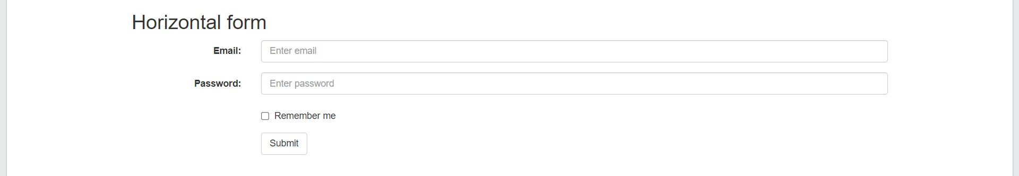
Bootstrap Horizontal Form
A horizontal form means that the labels are aligned next to the input field (horizontal) on large and medium screens.
On small screens (767px and below), it will transform to a vertical form (labels are placed on top of each input).
Additional rules for a horizontal form:
Add class .form-horizontal to the <form> element
Add class .control-label to all <label> elements
Tip: Use Bootstrap's predefined grid classes to align labels and groups of form controls in a horizontal layout.
<body>
<div class="container">
<h2>Horizontal form</h2>
<form class="form-horizontal" action="/action_page.php">
<div class="form-group">
<label class="control-label col-sm-2" for="email">Email:</label>
<div class="col-sm-10">
<input type="email" class="form-control" id="email" placeholder="Enter email" name="email">
</div>
</div>
<div class="form-group">
<label class="control-label col-sm-2" for="pwd">Password:</label>
<div class="col-sm-10">
<input type="password" class="form-control" id="pwd" placeholder="Enter password" name="pwd">
</div>
</div>
<div class="form-group">
<div class="col-sm-offset-2 col-sm-10">
<div class="checkbox">
<label><input type="checkbox" name="remember"> Remember me</label>
</div>
</div>
</div>
<div class="form-group">
<div class="col-sm-offset-2 col-sm-10">
<button type="submit" class="btn btn-default">Submit</button>
</div>
</div>
</form>
</div>
</body>

Slide 39
Bootstrap Navigation Bar

Slide 40
Bootstrap Navigation Bar
<!DOCTYPE html>
<html lang="en">
<head>
<title>Bootstrap Example</title>
<meta charset="utf-8">
<meta name="viewport" content="width=device-width, initial-scale=1">
<link rel="stylesheet" href="https://maxcdn.bootstrapcdn.com/bootstrap/3.4.1/css/bootstrap.min.css">
<script src="https://ajax.googleapis.com/ajax/libs/jquery/3.5.1/jquery.min.js"></script>
<script src="https://maxcdn.bootstrapcdn.com/bootstrap/3.4.1/js/bootstrap.min.js"></script>
</head>
<body>
<nav class="navbar navbar-default">
<div class="container-fluid">
<div class="navbar-header">
<a class="navbar-brand" href="#">WebSiteName</a>
</div>
<ul class="nav navbar-nav">
<li class="active"><a href="#">Home</a></li>
<li><a href="#">Page 1</a></li>
<li><a href="#">Page 2</a></li>
<li><a href="#">Page 3</a></li>
</ul>
</div>
</nav>
<div class="container">
<h3>Basic Navbar Example</h3>
<p>A navigation bar is a navigation header that is placed at the top of the page.</p>
</div>
</body>
</html>
A navigation bar is a navigation header that is placed at the top of the page:
With Bootstrap, a navigation bar can extend or collapse, depending on the screen size.
A standard navigation bar is created with
<nav class="navbar navbar-default">.

Slide 41
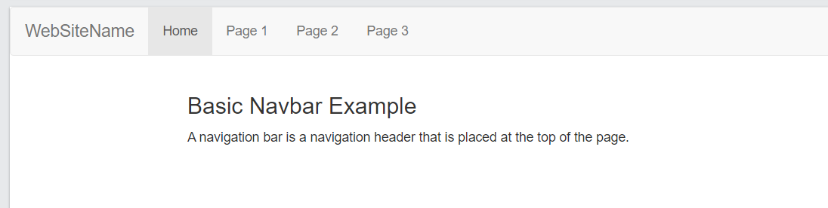
Bootstrap Navigation Bar
<!DOCTYPE html>
<html lang="en">
<head>
<title>Bootstrap Example</title>
<meta charset="utf-8">
<meta name="viewport" content="width=device-width, initial-scale=1">
<link rel="stylesheet" href="https://maxcdn.bootstrapcdn.com/bootstrap/3.4.1/css/bootstrap.min.css">
<script src="https://ajax.googleapis.com/ajax/libs/jquery/3.5.1/jquery.min.js"></script>
<script src="https://maxcdn.bootstrapcdn.com/bootstrap/3.4.1/js/bootstrap.min.js"></script>
</head>
<body>
<nav class="navbar navbar-default">
<div class="container-fluid">
<div class="navbar-header">
<a class="navbar-brand" href="#">WebSiteName</a>
</div>
<ul class="nav navbar-nav">
<li class="active"><a href="#">Home</a></li>
<li><a href="#">Page 1</a></li>
<li><a href="#">Page 2</a></li>
<li><a href="#">Page 3</a></li>
</ul>
</div>
</nav>
<div class="container">
<h3>Basic Navbar Example</h3>
<p>A navigation bar is a navigation header that is placed at the top of the page.</p>
</div>
</body>
</html>

Slide 42
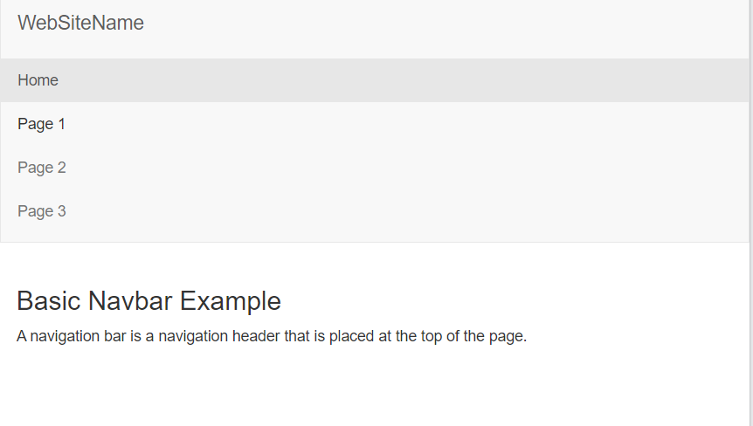
Bootstrap Navigation Bar
<!DOCTYPE html>
<html lang="en">
<head>
<title>Bootstrap Example</title>
<meta charset="utf-8">
<meta name="viewport" content="width=device-width, initial-scale=1">
<link rel="stylesheet" href="https://maxcdn.bootstrapcdn.com/bootstrap/3.4.1/css/bootstrap.min.css">
<script src="https://ajax.googleapis.com/ajax/libs/jquery/3.5.1/jquery.min.js"></script>
<script src="https://maxcdn.bootstrapcdn.com/bootstrap/3.4.1/js/bootstrap.min.js"></script>
</head>
<body>
<nav class="navbar navbar-default">
<div class="container-fluid">
<div class="navbar-header">
<a class="navbar-brand" href="#">WebSiteName</a>
</div>
<ul class="nav navbar-nav">
<li class="active"><a href="#">Home</a></li>
<li><a href="#">Page 1</a></li>
<li><a href="#">Page 2</a></li>
<li><a href="#">Page 3</a></li>
</ul>
</div>
</nav>
<div class="container">
<h3>Basic Navbar Example</h3>
<p>A navigation bar is a navigation header that is placed at the top of the page.</p>
</div>
</body>
</html>

Slide 43
Inverted Navigation Bar
<!DOCTYPE html>
<html lang="en">
<head>
<title>Bootstrap Example</title>
<meta charset="utf-8">
<meta name="viewport" content="width=device-width, initial-scale=1">
<link rel="stylesheet" href="https://maxcdn.bootstrapcdn.com/bootstrap/3.4.1/css/bootstrap.min.css">
<script src="https://ajax.googleapis.com/ajax/libs/jquery/3.5.1/jquery.min.js"></script>
<script src="https://maxcdn.bootstrapcdn.com/bootstrap/3.4.1/js/bootstrap.min.js"></script>
</head>
<body>
<nav class="navbar navbar-inverse">
<div class="container-fluid">
<div class="navbar-header">
<a class="navbar-brand" href="#">WebSiteName</a>
</div>
<ul class="nav navbar-nav">
<li class="active"><a href="#">Home</a></li>
<li><a href="#">Page 1</a></li>
<li><a href="#">Page 2</a></li>
<li><a href="#">Page 3</a></li>
</ul>
</div>
</nav>
<div class="container">
<h3>Basic Navbar Example</h3>
<p>A navigation bar is a navigation header that is placed at the top of the page.</p>
</div>
</body>
</html>
If you don't like the style of the default navigation bar, Bootstrap provides an alternative, black navbar
change the .navbar-default class into .navbar-inverse

Slide 44
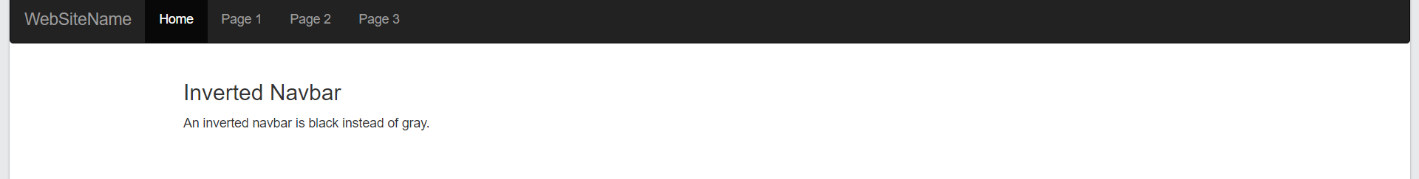
Inverted Navigation Bar
<!DOCTYPE html>
<html lang="en">
<head>
<title>Bootstrap Example</title>
<meta charset="utf-8">
<meta name="viewport" content="width=device-width, initial-scale=1">
<link rel="stylesheet" href="https://maxcdn.bootstrapcdn.com/bootstrap/3.4.1/css/bootstrap.min.css">
<script src="https://ajax.googleapis.com/ajax/libs/jquery/3.5.1/jquery.min.js"></script>
<script src="https://maxcdn.bootstrapcdn.com/bootstrap/3.4.1/js/bootstrap.min.js"></script>
</head>
<body>
<nav class="navbar navbar-inverse">
<div class="container-fluid">
<div class="navbar-header">
<a class="navbar-brand" href="#">WebSiteName</a>
</div>
<ul class="nav navbar-nav">
<li class="active"><a href="#">Home</a></li>
<li><a href="#">Page 1</a></li>
<li><a href="#">Page 2</a></li>
<li><a href="#">Page 3</a></li>
</ul>
</div>
</nav>
<div class="container">
<h3>Basic Navbar Example</h3>
<p>A navigation bar is a navigation header that is placed at the top of the page.</p>
</div>
</body>
</html>
If you don't like the style of the default navigation bar, Bootstrap provides an alternative, black navbar
change the .navbar-default class into .navbar-inverse

Slide 45
Navigation Bar with drop-down
<!DOCTYPE html>
<html lang="en">
<head>
</head>
<body>
<nav class="navbar navbar-inverse">
<div class="container-fluid">
<div class="navbar-header">
<a class="navbar-brand" href="#">WebSiteName</a>
</div>
<ul class="nav navbar-nav">
<li class="active"><a href="#">Home</a></li>
<li class="dropdown"><a class="dropdown-toggle" data-toggle="dropdown" href="#">Page 1 <span class="caret"></span></a>
<ul class="dropdown-menu">
<li><a href="#">Page 1-1</a></li>
<li><a href="#">Page 1-2</a></li>
<li><a href="#">Page 1-3</a></li>
</ul>
</li>
<li><a href="#">Page 2</a></li>
<li><a href="#">Page 3</a></li>
</ul>
</div>
</nav>
<div class="container">
<h3>Navbar With Dropdown</h3>
<p>This example adds a dropdown menu for the "Page 1" button in the navigation bar.</p>
</div>
</body>
</html>
Navigation bars can also hold dropdown menus.

Slide 46
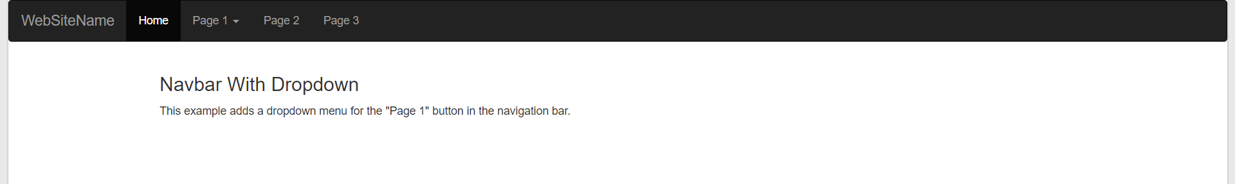
Navigation Bar with drop-down
<!DOCTYPE html>
<html lang="en">
<head>
</head>
<body>
<nav class="navbar navbar-inverse">
<div class="container-fluid">
<div class="navbar-header">
<a class="navbar-brand" href="#">WebSiteName</a>
</div>
<ul class="nav navbar-nav">
<li class="active"><a href="#">Home</a></li>
<li class="dropdown"><a class="dropdown-toggle" data-toggle="dropdown" href="#">Page 1 <span class="caret"></span></a>
<ul class="dropdown-menu">
<li><a href="#">Page 1-1</a></li>
<li><a href="#">Page 1-2</a></li>
<li><a href="#">Page 1-3</a></li>
</ul>
</li>
<li><a href="#">Page 2</a></li>
<li><a href="#">Page 3</a></li>
</ul>
</div>
</nav>
<div class="container">
<h3>Navbar With Dropdown</h3>
<p>This example adds a dropdown menu for the "Page 1" button in the navigation bar.</p>
</div>
</body>
</html>
Navigation bars can also hold dropdown menus.

